Slide 1



National
Anti-drug
Campaign

Slide 2
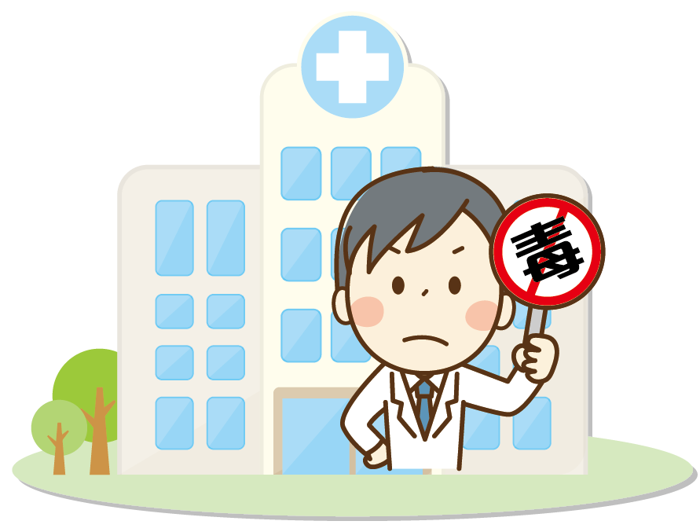
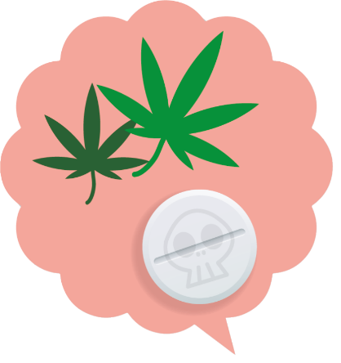
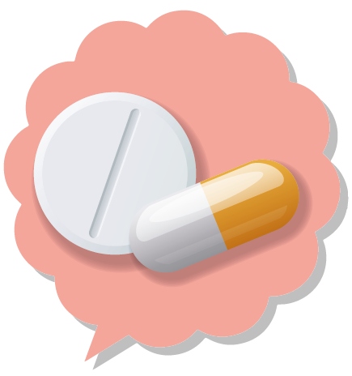

Definition of narcotics and controlled drugs
Narcotics
According to Article 2 of Narcotics Hazard Prevention Act
The term Narcotics in this Act refers to those narcotic drugs and their derivative products that are habit-forming, cause abusive usage, and are a danger to society, and other substances and their products that affect psychological behavior.
Controlled drugs
According to Article 3 of Controlled Drugs Act
The term “controlled drugs” as used in this Act refers to the following types of drugs: 1. addictive narcotic drugs 2. psychotropic drugs 3. other drugs requiring regulation

Slide 3


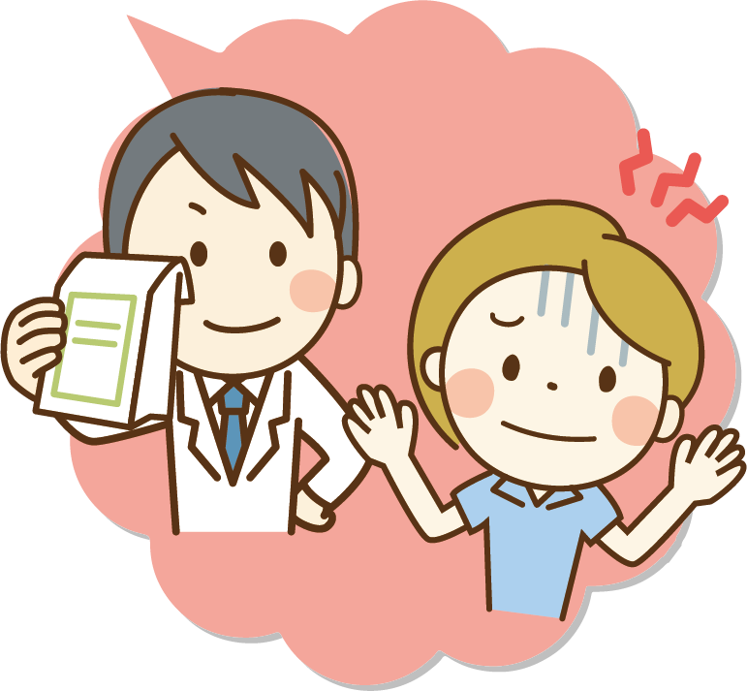

Narcotics and controlled drugs are two sides of the same coin
Illegal narcotics
Drugs that harm people
Physician’s prescription
Pharmaceuticals that cure disease and save lives

Slide 4




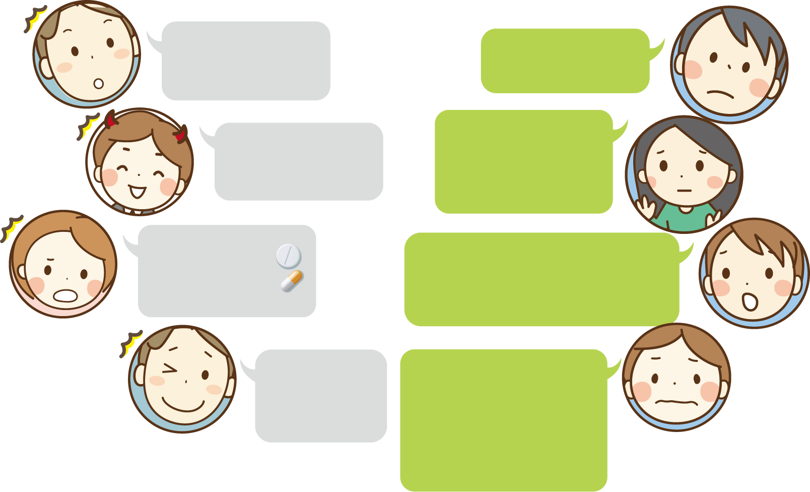

Beautiful mask Hidden cruel truth
You think drugs can…
Cruel truth
help lose weight, to have perfect figure
Haggard, shriveled and diapered
Yesterday
10:30 a.m.
10:31 a.m.
help build connections, everyone will admire me.
People think you have complicated friends, and that gets you upset more.
11:30 a.m.
11:35 a.m.
Friends call, just once cannot be addicted!
Words used by drug dealers. Drugs are addictive and will make you stuck.
11:46 a.m.
Today
Read 11:55 a.m.
Taking drugs can cause hallucinations, cognitive impairment, or mental illness. It may result in bladder fibrosis, then you have to wear diapers for the rest of your life, which will, on the contrary, reduce your “sexual” desire.
Do drug can regain my virility!
12:30 p.m.
13:31 p.m.

Slide 5

Don’t let drugs control your life! (1)
Establish the positive work attitude and professional dedication
Be open to job challenges and speak out your thoughts.
Seek cooperation and assistance when facing stress.

Slide 6

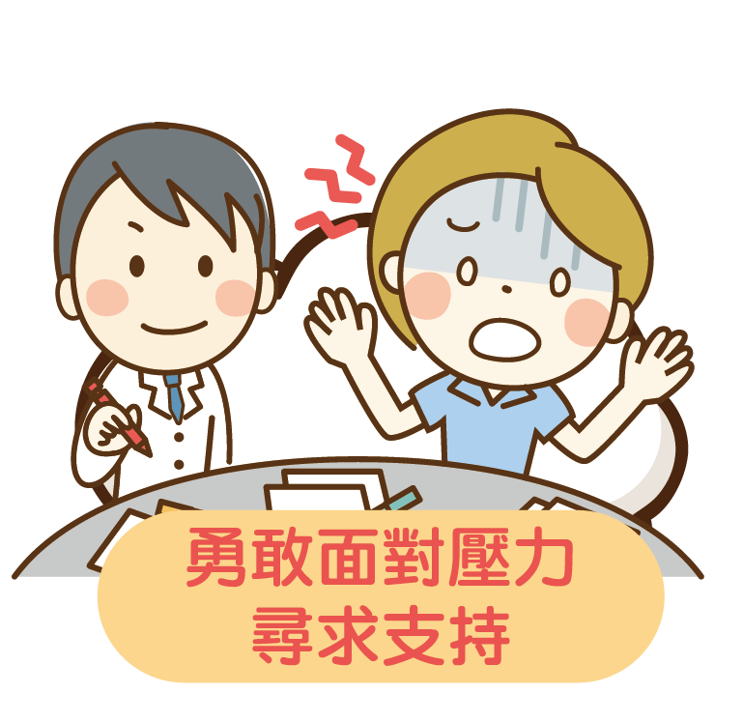

Don’t let drugs control your life! (2)
Develop good interpersonal relationships
Vent emotions in a timely manner, to relax body and mind.
Be brave to face stress, seek support when needed.
Share thoughts with others, care for others with empathy.

Slide 7


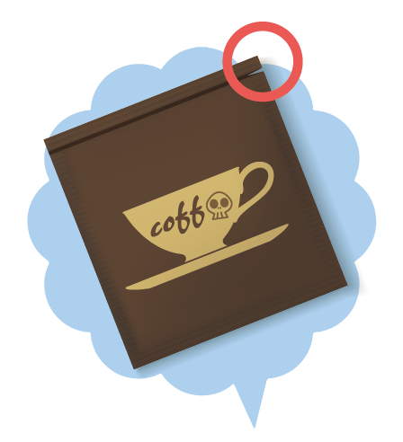



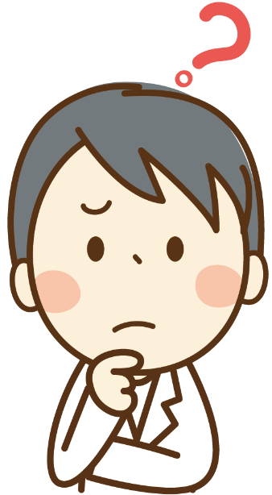

Newly emerging drugs in disguise
All the following
may be drugs
Re-packed fake brands
e.g. toxic coffee packets, toxic milk tea packets
Adulterated into general food
e.g. toxic herbal tea
Disguised other than food, e.g. toxic lased postage stamps
Snack-like packed drugs to lure teenagers
Food Drugs
Hotline to report a drug dealer

Slide 8

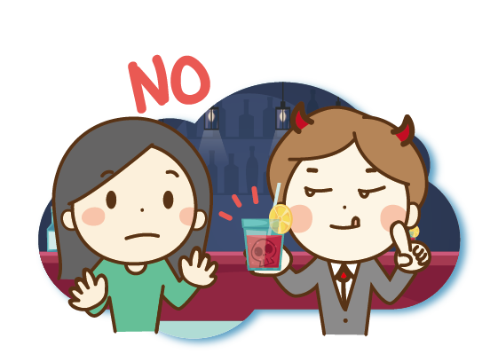
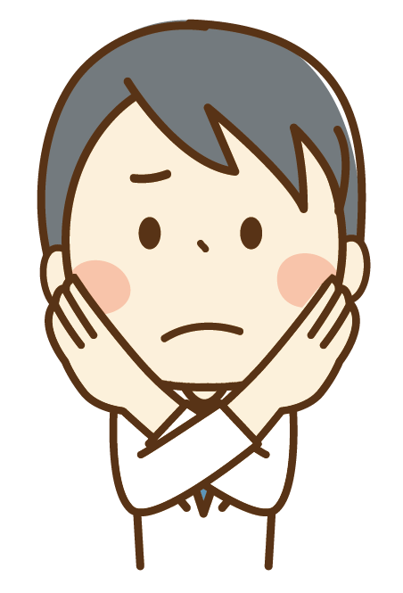

You can avoid the hazards of newly
emerging drugs (1)
Stay away from strange places .
Be alert, and do not accept drinks or food from strangers!
In case of suspicion, leave the site as soon as possible, seek help from reliable persons and call the police.

Slide 9



You can avoid the hazards of newly
emerging drugs (2)
Don’t try dubious goods, candy, coffee packets with strange packaging!
Be very alert to friends’ friends! Do not take any suspicion lightly!
Pay attention to food packaging to avoid falling prey of traps!

Slide 10
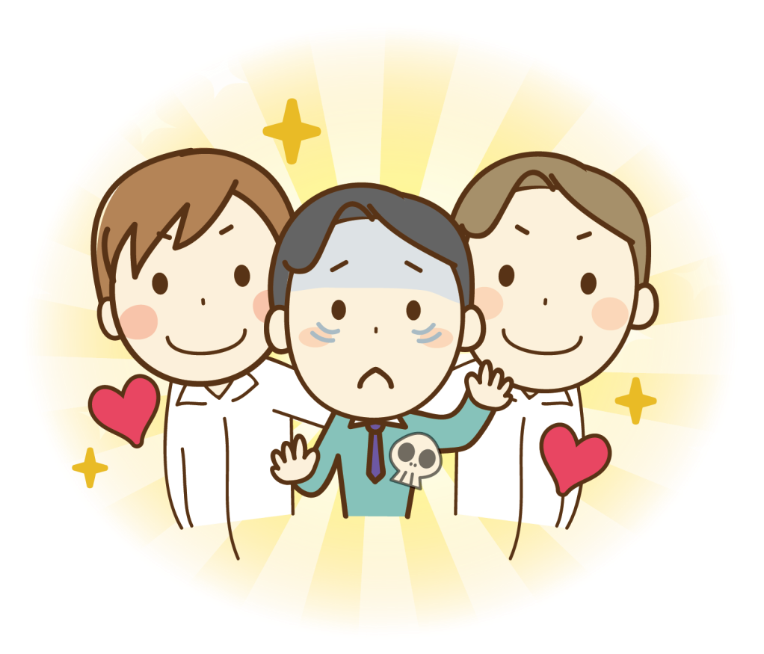
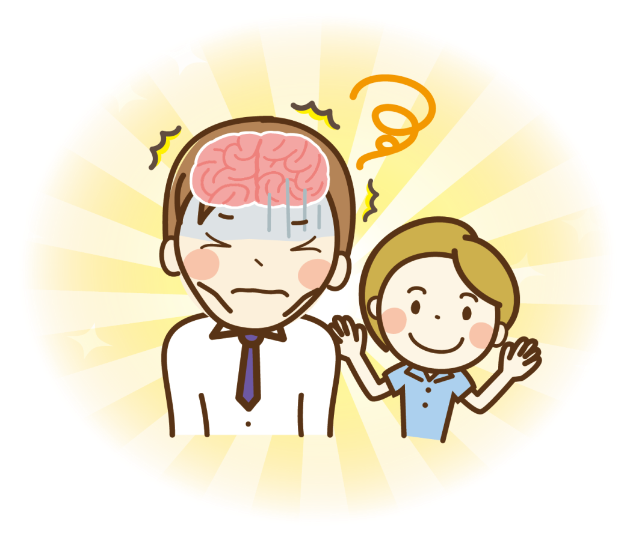

Timely care
and Supportive assistance
Addiction is a chronic brain disease. Successful drug quitting calls for accepting those who are trying to quit and supporting them to return to society.
When family members, friends and colleagues show signs of drug use, provide timely care and seek assistance from professionals (call the hotline).
Drug Abuse Prevention Center Consultation Hotline

